Slide 1


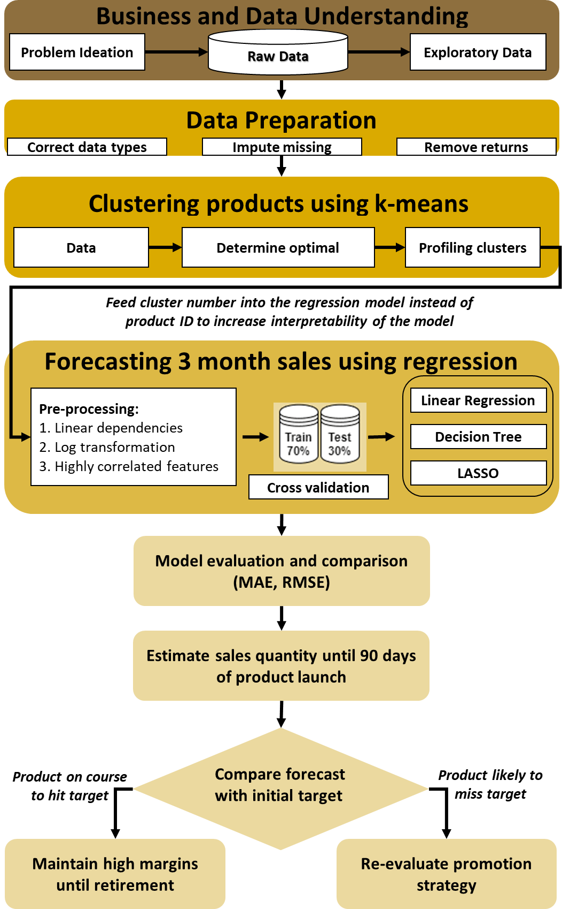
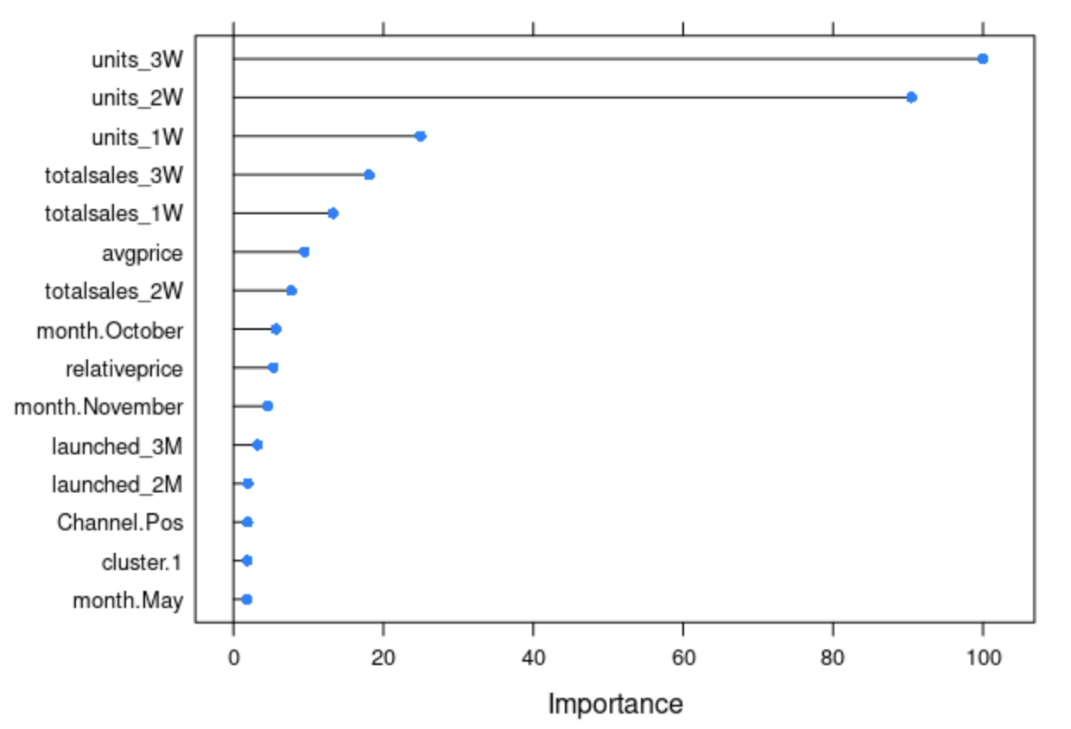
New Product Performance Prediction in Fashion Retailing
Anjali Hegde, Gajender Saharan, Jeffrey Chittaranjan, Ruthvik Arepalle, Shruti Gupta, Matthew A. Lanham
Purdue University Krannert School of Management
hegde11@purdue.edu; gsaharan@purdue.edu; jchittar@purdue.edu; rarepall@purdue.edu; gupta592@purdue.edu; lanhamm@purdue.edu
`
ABSTRACT
METHODOLOGY
RESULTS
Most fashion retailers place inventory orders and investments well in advance. However, poor product performance can result in excess inventory which need to be liquidated through heavy promotions. It can hit their bottom line and tarnish their reputation.
We have developed a machine learning model that can be used to predict whether a newly launched product will be successful by fusing traditional sales data with cannibalization features. Our model can also be used to identify the right product characteristics, seasonal and geographic trends of successful products for future product launches.
Multiple Linear Regression was chosen since it generalized the best compared to other models and our business partners placed higher importance on interpretability rather than accuracy.
The third week sales after launch is found to be very significant factor in estimating the sales quantity by the third month. A 10% increase in third week sales, led to 7.5% increase in 3-month sales
INTRODUCTION
Currently, most fashion retailers liquidate non-performing products by giving high discounts which affect long term health of the brand and reduce profit margins. According to a 2018 report by Celect and Coresight Research, markdowns cost US non-grocery retailers $300 Billion in revenue annually
Day 1
Steep discounts for unsuccessful products
…
...
Retirement
Product Launch
Reduced margins
Forecast sales until Day 90
Healthy margins
and inventory
Day 1
Day 21
….
Retirement
Fig 3. MAE Comparison of Models
Fig 4. Feature Importance Chart
Product Launch
Re-evaluate promotion strategies
CONCLUSIONS
Fig 1. Current and proposed product lifecycle timeline
The first three weeks of sales data, along with product characteristics, location details, launch season and cannibalization features are a good predictor of the product’s success.
Products launched 30 days and 60 days prior to a new launch are found to have a negative impact on the new product performance.
For every product launched 60 days prior to a new product’s launch, the sales of the newly launched product reduces by 7%.
Research questions:
Are the first 3 weeks of a product’s launch predictive of determining 3-month sales ?
Do high performing products have certain characteristics (colors, product categories, geographical trends, price, margins) that the less selling products lack?
How much does the cannibalization impact the sales of newly launched products?
DATA
SKU
Features such as size, color, product characteristics, launch date, retirement data, category, etc.
POS
Transactional level data from POS in full-line stores – includes order date, SKU, store ID, price, margins, discount
Fig 5. Effect of Cannibalization for category X
Web
Transactional level data retailer’s website – includes order date, SKU, price, margins, discount
ACKNOWLEDGMENTS
Store
Geographical features of the full-line stores
We thank Professor Matthew Lanham and our industry partner for constant guidance on this project.
Fig 2. Process Flow
Notes:
https://www.skunexus.com/blog/how-to-avoid-inventory-overstocks-and-understocks

